Slide 1
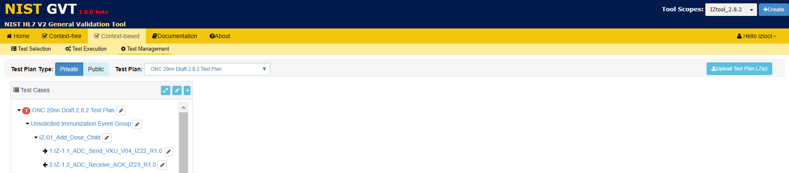

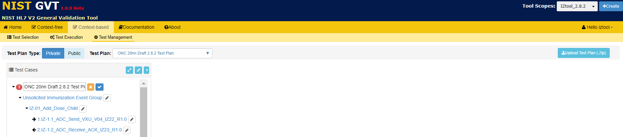


Context-based Test Management: How to Edit a Test Plan in GVT
Logged on as a Deployer Type Account User, select Context-based validation, and then select the Test Management function
2
Click on Private or Public and select a Test Plan from the Test Plan dropdown menu
Click on an Edit icon
1
3
Over-write the verbiage in the edit field, and then
Click on the Save icon to accept the edit or
Click on the Reset icon to reverse the edit
4

Slide 2
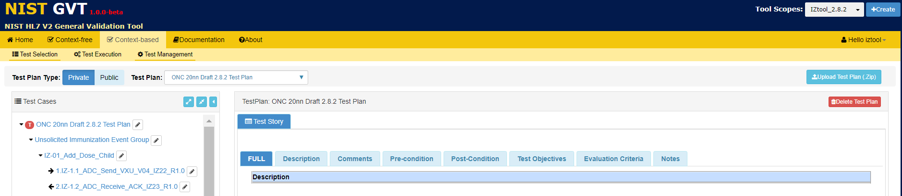
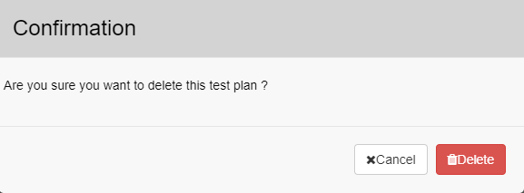
Context-based Test Management: How to Delete a Test Plan in GVT
Logged on as a Deployer Type Account User, select Context-based validation, and then select the Test Management function
2
Click on Private or Public and select a Test Plan from the Test Plan dropdown menu
Click on the Root of the Test Plan
1
3
Click on Delete Test Plan
4
5
Click on Delete to confirm

